Slide 1




MODELS FOR EVALUATING THE QUALITY OF DISTANCE AND ONLINE HIGHER EDUCATION IN LATIN AMERICA AND THE CARIBBEAN
MARY MOROCHO QUEZADA
Latin American and Caribbean Institute for Quality in Higher Distance Education (CALED)

Slide 2


1991 - CIEES
1992 - CNA Colombia
1995 - CONEAU
1999 - SINAES
2000 - COPAES
2023 - ANEAES
2006 - CNA Chile
2006 - CONEAUPA
2006 - SINEACE
2018 - CACES
Accreditation
https://media.istockphoto.com/id/1324415819/es/v%C3%ADdeo/mapa-de-am%C3%A9rica-latina-digital-4k.jpg?s=640x640&k=20&c=WCaRkSGm1-wL8RaDiPAuGTRpx-vXgWEOHN1vSGDSiMY=

Slide 3



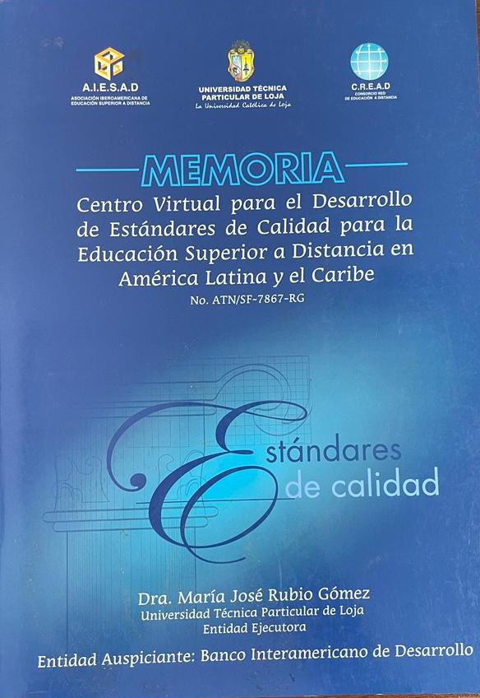

Initiatives in Latin America and the Caribbean
Project "Virtual Center for the Development of Quality Standards for Distance Higher Education in Latin America and the Caribbean"

Slide 4

CREATION OF THE LATIN AMERICAN AND CARIBBEAN INSTITUTE FOR QUALITY IN DISTANCE HIGHER EDUCATION - "CALED“
19/10/05 UTPL-Loja
In the context of the I Congreso Cread Andes and I Encuentro Iberoamericano Virtual Educa, about "Quality and International Accreditation in Distance Education

Slide 5






Accreditation agencies and organizations
https://cdn.pixabay.com/photo/2022/06/03/21/55/flags-7240868_1280.jpg

Slide 6

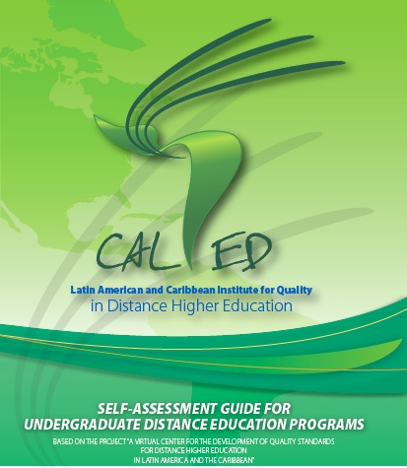


CALED has the:

Slide 7

Evaluation guide for distance undergraduate programs
9
30
148
333
Leadership and Management Style
6. Outcomes /of Target Audiences and Educational Processes
Criteria
Subcriteria
Standards
Indicators
2. Policy and Strategy
3. People Development
7. People Development Outcomes
4. Resources and Partnerships
8. Society Outcomes and,
9. Global Results,
5. Target Audience /and Educational Processes
Enabling Processes
Outcomes

Slide 8
Scorecard (SCCQAP) OLC/CALED
INSTITUTIONAL SUPPORT
2. TECHNOLOGICAL SUPPORT
3. DEVELOPMENT AND INSTRUCTIONAL DESIGN OF ONLINE COURSES
The quality assurance process for online and distance education
Scorecard (SCCQAP)
Evaluation of Online Undergraduate Programs
First version
9
4. STRUCTURE OF ONLINE COURSES
Categories
5. TEACHING AND LEARNING
91
Indicators
6. SOCIAL AND STUDENT PARTICIPATION
7. TEACHER SUPPORT
8. STUDENT SUPPORT
9. EVALUATION AND ASSESSMENT
The quality assurance process for online and distance education.
Scorecard (SCCQAP)
Evaluation of online undergraduate programs
First version

Slide 9

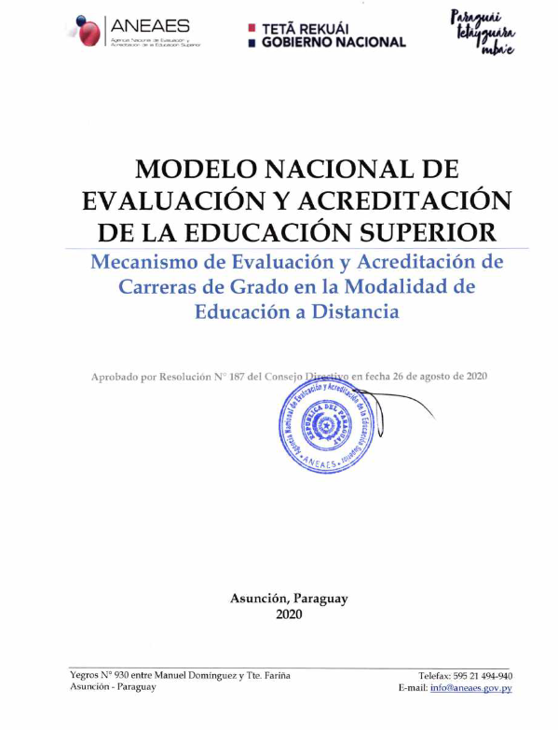
ANEAES evaluation models
14
30
5
Career governance
Dimensions
Academic Project
Components
Criteria
NATIONAL MODEL FOR THE EVALUATION AND ACCREDITATION OF HIGHER EDUCATION
People
Mechanisms for the Evaluation and Accreditation of Distance Education Degree Programs
Resources
Results and impact

Slide 10
MATRIX FOR THE EVALUATION OF THE QUALITY OF POSTGRADUATE DISTANCE LEARNING PROGRAMS
1
6
Program Management
2
Academic Project
Dimensions
80
6
3
Faculty
Indicators
4
Infrastructure and Personnel
Criteria
39
5
Research
6
Responsibility and Social Linkage

Slide 11
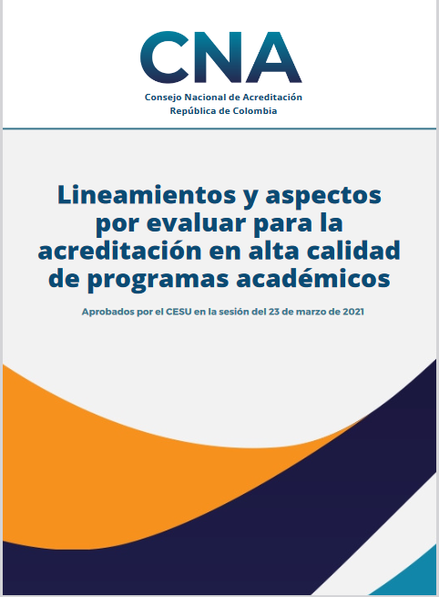
The factors for the high quality accreditation of academic programmes are:
1. Educational project of the programme and institutional identity
2. Students
3. Teachers
4. Graduates
5. Academic aspects and learning outcomes
6. Permanence and graduation
7. Interaction with the national and international environment
8. Contributions of research, innovation, technological development and creation associated with the academic programme
9. Welfare of the academic community of the programme
10. Educational means and learning environments
11. Organization, administration and financing of the academic programme
12. Physical and technological resources.
Guidelines and aspects to be evaluated for the high-quality accreditation of academic programs
CHARACTERISTICS
FACTORS
48
12
104
ASPECTS BY EVALUATOR

Slide 12

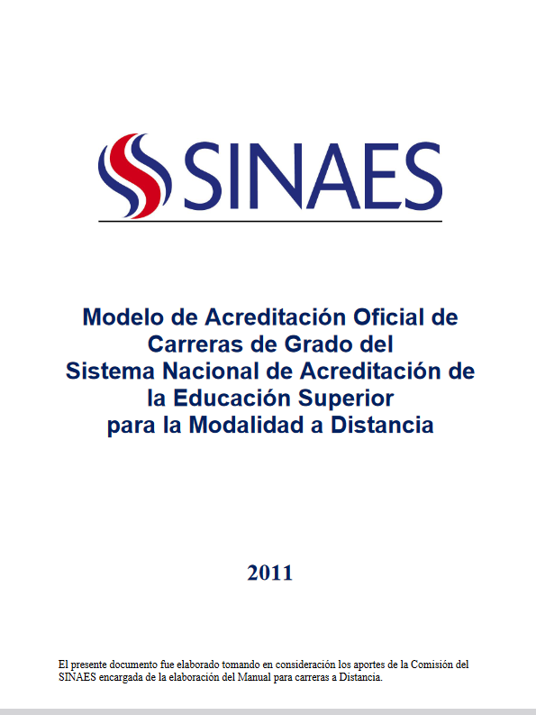
Structure of the SINAES accreditation model for undergraduate degree courses
Relationship with the context
Resources
Educational process
4
Results
4
Dimensions
Model of Official Accreditation of Degree Programs of the National System of Accreditation of Higher Education for the Distance Mode
21
Components
168
Criteria
38
Standards
SINAES. (2011). Modelo de Acreditación Oficial de Carreras de Grado del Sistema Nacional de Acreditación de la Educación Superior para la Modalidad a Distancia.

Slide 13

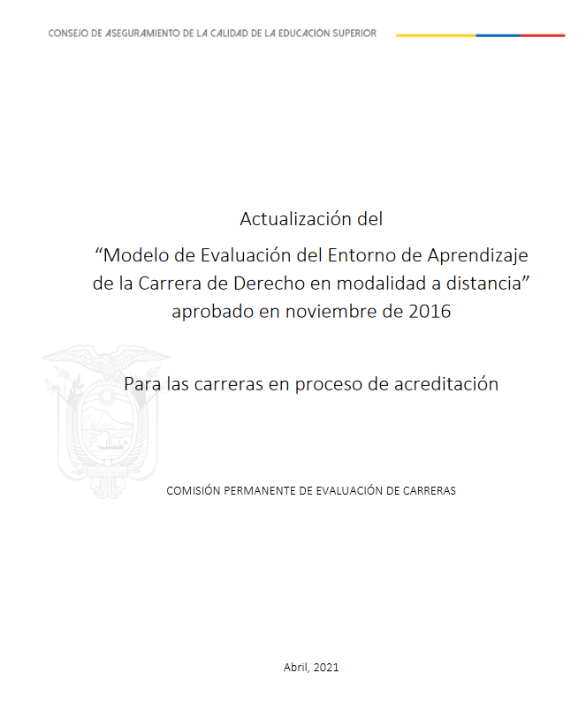
Pertinence
Updating of evaluation models
Council for Quality Assurance in Higher Education (CACES)
Academy
Curriculum
Students
5
Criteria
Technological infrastructure
Update of the "evaluation model of the learning environment of the distance mode law degree program" approved in November 2016.
For a career in the process of accreditation
12
Subcriteria
Indicators
38

Slide 14

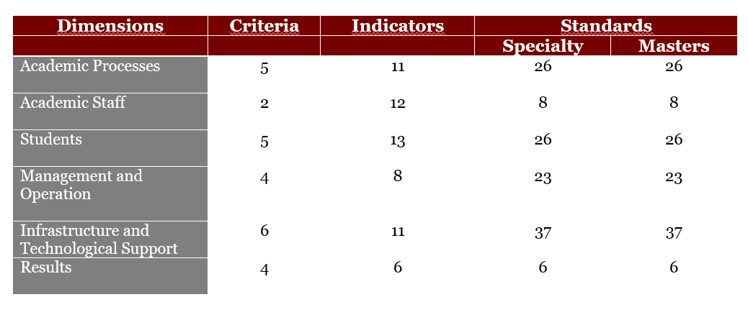

Development of the Ibero-American Kalos Model for postgraduate programmes in Distance Education

Slide 15




PENDING ACTIONS
The Latin American region requires:
Accreditation agencies and bodies to review and update the instruments for the evaluation of distance and online education.
Establish a framework of internationally comparable and compatible standards.
Consolidate teams of experts in distance and online education evaluation processes.
Accreditation agencies need to be part of the digital ecosystem of educational innovation and transformation.
Develop collaborative work between networks, higher education institutions and evaluation agencies to consolidate true quality assurance systems.

Slide 16

Mary Morocho Quezada memorocho@utpl.edu.ec
www.caled-ead.org

