Slide 1


Designing Online Assessment
Solutions that are rigorous, trusted, flexible and scalable
George Ubachs, Director, EADTU, The Netherlands
Klaus-Dieter Rossade, Director Assessment Programme, The Open University, UK

Slide 2
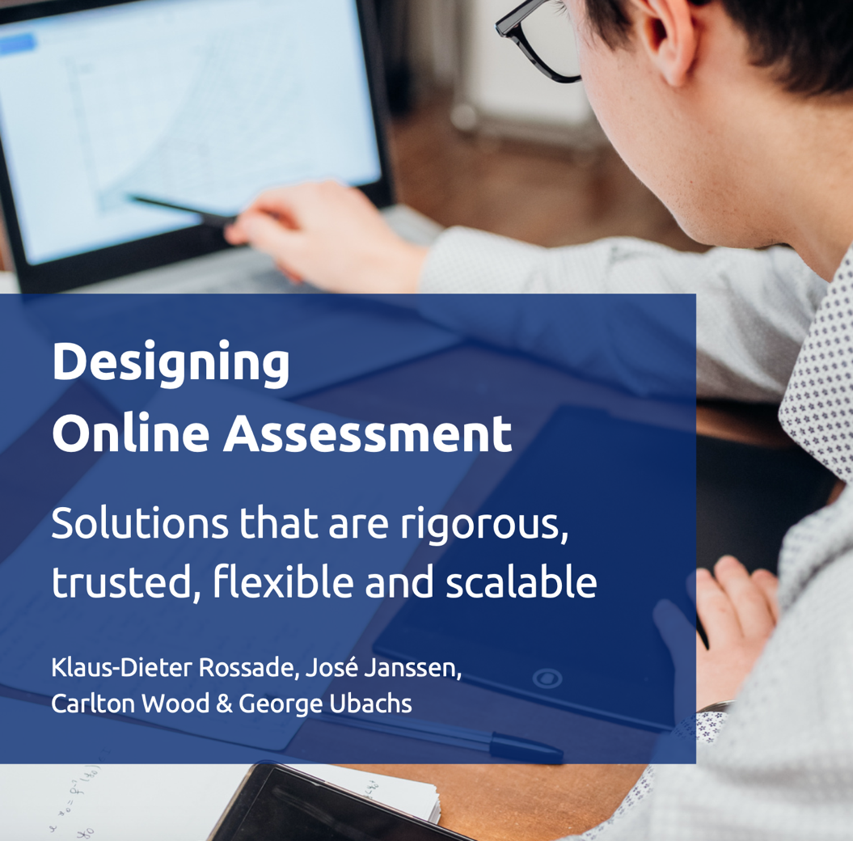
Online Assessment Special Interest Group
Establishment of SIG January 2020
18 members institutions from 14 countries
37 HE practitioners + 18 contributors of good practice
15 Good Practice case studies
4 Focus areas
  Assessment Futures
  Assessment Design
  Trust, Privacy and Ethics
  Operational processes, technology and support
Link to report: https://zenodo.org/record/6563226#.Y-PFNS-l0Tt
Link to EADTU SIG-website: https://online-assessment.eadtu.eu

Slide 3

Assessment Future is already present
Not only as response to Covid, but anticipating on increase in online and flexible offerings (Micro-credentials, Short courses)
Online Assessment is here to stay
Great variety of hybrid solutions to online assessment
Notes:
Mood change is palpable

Slide 4


Operational processes, technology and support
Text
Challenges during the pandemic
How did institutions organise themselves to deliver the required operational processes?
Could face-to-face provision be adapted for on-line delivery?
To what extent was technology deployed to assist in the delivery of operational process?
How did Universities support staff and students whilst delivering the process?

Slide 5
Assessment design
There is a clear need for greater authenticity and personalization of assessment design.
Choice of flexibility must be included in the assessment design.
Comprehensive instructions and spelling out assessment criteria have gained a new practical meaning.
Formative evaluation and feedback before final examination works not only as support but also as a way of reducing the motivation for cheating.
Although the majority of students are able to work independently, some enjoy support from teachers and other students in forums and online meetings. Learning environments and various meeting applications allow group study and peer support. They also help educators arrange a social and communal aspect to learning.

Slide 6
Trust is a two-way street
Trust, Privacy and Ethics
“It’s nasty to be treated as a fraud suspect”
“To feel you’re being watched is very unpleasant. I even didn’t dare look out of the window for fear of being considered a fraud”
Student evaluation, in: Nielissen, 2021
“Academic integrity is a pedagogical issue and should not be limited to not getting caught during an exam. We need to be able to trust our students that they will not lie about their methods, falsify their results or plagiarise. These are fundamental values of academic work and need to be developed as such.”
SIG member Henrietta Carbonell, personal communication, 10-2-2022

Slide 7
Trust, Privacy and Ethics
We need to teach our students to be critical of the surveillance society in which we live, not force them to accept it.
Flexible delivery is a key asset of online and distance teaching universities. It could be argued that all is fine as long as students have a choice, as a considerable group of students still prefers to take an exam on-campus.
It is a culture of academic integrity that needs to be taught as part of academic education
Notes:
-students not a potential fraud, but show a reliable system that ensures quality of grades achieved in the benefit of the student
-offer students with anxiety in only assessment always an alternative in an on-site environment
-it is a culture of academic integrity that needs to be taught as part of academic education (Henrietta, 2nd comment)

Slide 8

Principles for future assessment (JISC 2020-2025)
Authentic, i.e. a move away from acquiring knowledge to acquiring transferable skills assessed in a more realistic way;
Accessible i.e. the aspiration to design assessment within an accessibility-first principle and delivered in multiple ways depending on the needs of future learners;
Appropriately automated which includes a mix of automated and human marking and feedback that benefits learners;
Continuous refers to the data and analytics to assess the effectiveness and impact of continuous assessment; and
Secure which should include elements of authoring detection and biometric authentication for identity and remote proctoring
JISC (2020). The future of assessment: five principles, five targets for 2025. https://repository.jisc.ac.uk/7733/1/the-future-of-assessment-report.pdf

Slide 9
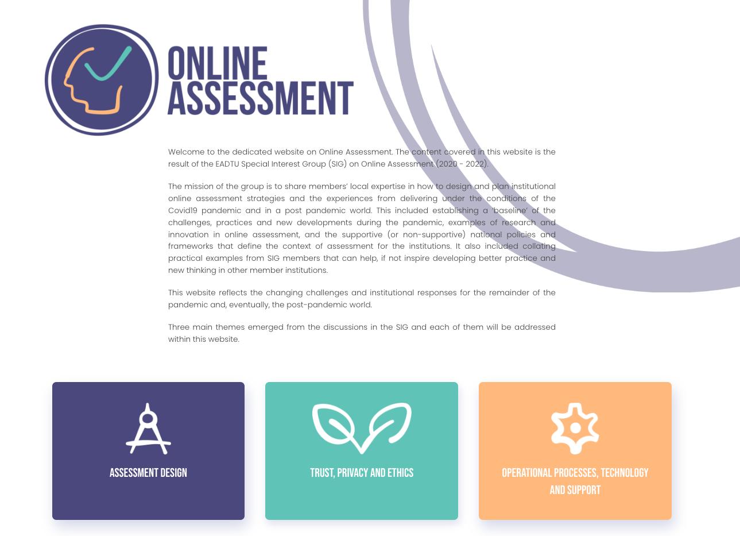
https://online-assessment.eadtu.eu/

Slide 10

Then came generative AI

Slide 11

What We Are Saying to Students
  Try Generative AI tools
  Critically evaluate responses
  Take responsibility for ethical usage
  Over-reliance on Generative AI prevents development of important personal and employability skills
  Do not put OU materials into commercial sites/tools

Slide 12

What We Are Saying to Staff
  Try Generative AI tools
  Openly engage with students
  Remind students of value of assessments and feedback
  Remind students of Academic Conduct Policy
  Rethink curriculum and assessment
  Do not put OU materials into commercial sites/tools

Slide 13

A teacher’s guide to ChatGPT and remote assessments
Link
March 2023

Slide 14
Ideas for assessments
you may want to try out in your modules
2.1 General considerations when redesigning an assessment
You may want to consider the following aspects:
What is the purpose of your module, Review your intended learning outcomes. Should these be adapted for the world in which our students will be working 10 years from now? Are your assessments aligned with these goals?
More than ever emphasise the importance of academic integrity.
What are important values for you as a teacher? Academic integrity, trust, fairness, engagement and motivation, validity (is my assessment measuring what I want), surveillance (how much surveillance is acceptable in our society and university?). We need to pay attention and openly discuss these ethical questions (Cowen, 2022). Get students involvement.

Slide 15
General tips:
Set clear expectations (what is allowed) for the use of LLM tools in your syllabus:.
Make exams meaningful and motivating to the students: choice (topic, specific case, but also in the ways of showing their knowledge), test higher cognitive skills, authentic tasks.
You may want to ask for shorter essays so you can focus more closely on the argument, critical analysis, link to a specific context, check the references, etc.
Offer a combination of different types of exams.
More than ever learning requires trust, transparency and involvement.
Make sure the time constraints are flexible and encourage students to use the flexibility if they do not feel prepared. Cheating increases if students feel they are trapped. Offer extensions when needed (better than cheating). Make sure to take time to explain the assignment and discuss it with the students. See Amigud and Lancaster (2019) on reasons for cheating.

Slide 16
  Ideas for assessments in a world with ChatGPT
Ask the students to use ChatGPT to answer a question you have asked or that they have come up with. It should be a challenging question without a clear answer. Then ask the students to do one or all of the following:
Option 1
Critically evaluate the response Add references
Improve the outcome using ‘track changes’ to highlight their work

Slide 17
1. Prompt Competition (taken from Ryan Watkins)
Option 2
Notes:
Prompt Competition (taken from Ryan Watkins) • Identify a major question or challenge in your field or discipline that ChatGPT could write about. Preferably a question with no clear single right answer. • Have students collaborate (in pairs or small teams) on developing 5 to 10 criteria for assessing ChatGPT responses to the major question. For example, ChatGPT’s output references more than one theoretical perspective. • Ask students to individually write a prompt for ChatGPT to answer the major question. • Have students use their criteria to judge other students’ responses (in pairs or small teams) and rate the ChatGPT prompts/responses from best to worst.
2; choose ai or not. If not sign statement. If used, use track changes where you added or changed outcome ai.
3. Link cases with theories, research and include evaluation of student to outcome
4.Feedforward by teacher at mulitple stages in devloment of final outcomes. Make relations to own experiences, current events, etc
5. Explain the process. Develop metacognitive understandings and reflectivity.
6. Oral exeminations
7.Show your knowledge over different channel like, video, podcast, mindmap

Slide 18
References
Boud, D. 1995. “Assessment and Learning: Contradictory or Complementary?” In Assessment for Learning in Higher Education, edited by P. T. Knight, 35–48. London.
JISC (2020). The future of assessment: five principles, five targets for 2025. https://repository.jisc.ac.uk/7733/1/the-future-of-assessment-report.pdf
Emerge and JISC (2020). Assessment Rebooted. From 2020s quick fixes to future transformation. https://repository.jisc.ac.uk/7854/1/assessment-rebooted-report.pdf
Kevin Ashford-Rowe, K, Janice Herrington, J. and Brown, C (2014) Establishing the critical elements that determine authentic assessment, Assessment & Evaluation in Higher Education, 39:2, 205-222, DOI: 10.1080/02602938.2013.819566
Nielissen, G. (2021). Studeren in coronatijd. Thuistentamens en andere aspecten van studeren in de coronaperiode. Open Universiteit. Expertisecentrum Onderwijs (ECO).
Shute, V. J., Y. J. Kim. 2013. “Formative and Stealth Assessment.” In Handbook of Research on Educational Communications and Technology, 4th ed., edited by J. M. Spector, D. M. Merrill, J. Elen, and M. J. Bishop, 311- 321. New York: Springer Science Business Media.
A teacher’s guide to ChatGPT and remote assessments, Unidistance.ch, March 2023

