Slide 1



The International Council for Open and Distance Education
Quality Network
Ask the ICDE Experts Event 2
“Quality of Online Assessment and the Impact of ChatGPT”
September 12, 2023

Slide 2
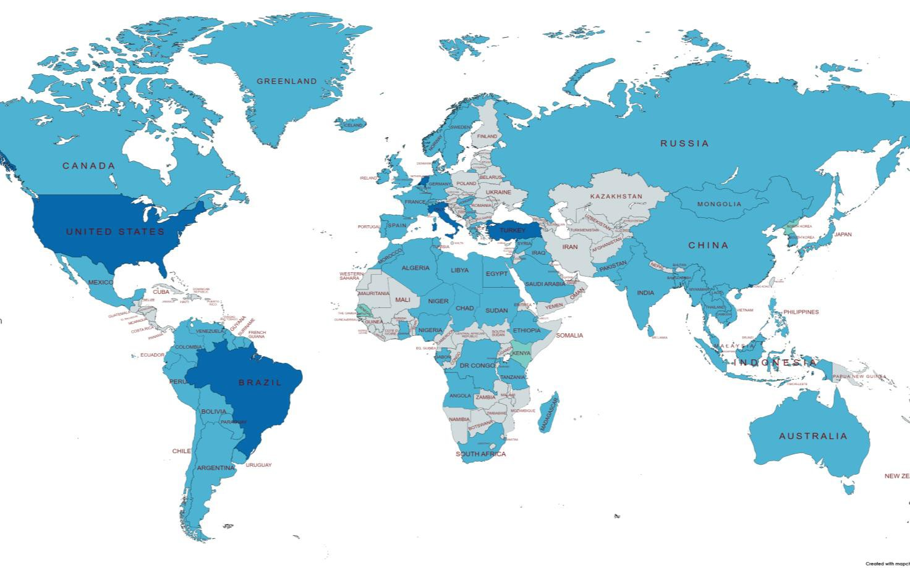
ICDE Quality Network
Leading and coordinating role for quality enhancement of open, flexible and distance education.
North
America
Europe
Latin
America
Africa
Asia
Arab
Region
Oceania

Slide 3
Mandate 2023-24
I. Enlighten, inspire, and encourage the adoption of high-quality standards and best practices in open, online, flexible, and distance education.
Webinars and Peer
Learning Events
ICDE WC panel in Costa Rica: Regional Perspectives on QA: Good Practices in the Age of Digital Education
Support the development of ICDE Global Advocacy Campaigns for open, flexible and distance learning (OFDL).
Support the ICDE Conferences and Events.
Represent ICDE in external conferences and
events relevant to quality.
QN 2023 Report “Global Quality Perspectives on Open, Flexible and Distance Learning”
Quality Resources Web Space

Slide 4
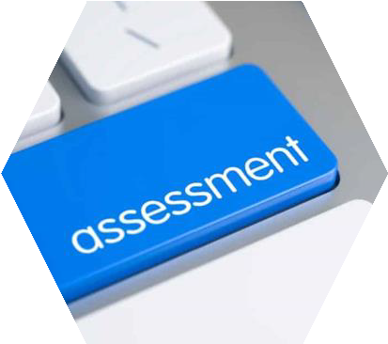




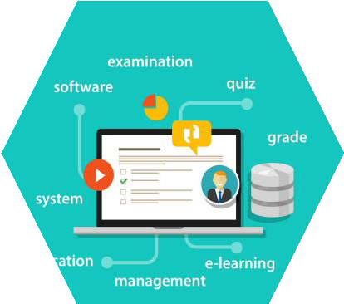
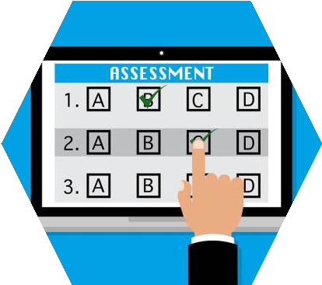


Quality of Online Assessment
Policy and process for moderation
Effective online assessment strategies
Explanatory and confirmatory feedback
Information Security
Policy and process for authenticating students' work
Clear rubrics and guidelines
Variety of valid, reliable, and effective online assessment tools
Copyright © 2023 HBMSU - Dr. Souma Alhaj Ali - All Rights Reserved

Slide 5



Authenticity and Academic Integrity
AI co-authoring tools, though offering huge potential for good instructional practices, possesses huge challenges for educators in authorship and academic integrity.
Issues related to academic integrity can be solved through 3 main dimensions:
Behaviour
Pedagogy
Technology

Slide 6

Behaviour
Learners’ awareness
Original work
Attribution
Factual accuracy
Information Security
Policies and guidelines
Compliance with laws and regulations
Responsible use of AI
Open and honest conversations

Slide 7
Pedagogy
Use valid authentic assessments and performance-based assessments .
Require the application of knowledge and skills in real-world situations.
Personalized and context-based assessment.
Staged submission.
Viva presentation and oral examination.
Consider other aspects including: accuracy and validity, demonstration of learning, transfer of knowledge, collaboration, and flexibility.

Slide 8



Technology
Plagiarism Detection Software
Online Remote Proctoring
Pre- Authentication
Browsing Tolerance
Disenable Copy- paste
Disable auto- complete
Submission view
(hide answers)
Remotely Authorize and Control
Behavioral alerts
Report
Generation
8

Slide 9
Thank You

Slide 10
Closing Remarks

Slide 11

Use of AI in Education
Delivery strategies
Pedagogies
Content and T&L Resources
Assessment
T&L ecosystem
Administration
AI to ASSIST not to REPLACE faculty and teachers

Slide 12
Way forward
AI will transform education; HE has to be ready and embrace the change:
Be receptive and proactive.
Proper planning and change management.
Faculty and administrators’ development.
Ethical and responsible use of AI: Handle issues related to privacy and information security.
Avoid bias: Work together to ensure that AI-powered tools and technologies are equitable and accessible to all.
Monitor the outcomes (educational, economical, and societal) and amend strategies accordingly.
Consider the impact of AI on the future of job market and changes needed on:
Choice of programs.
Design of program and learning outcomes.
Graduates’ skill set.

Slide 13


Quality Network
Ask the ICDE Experts Event 3
Ask the ICDE Experts Event 3
Topic: “Quality models in regional frameworks, including T&L Resources”
Date and Time: 7 December, 14.00-15.00 CET time
Speakers: ICDE focal points on Quality from Latin America, Asia, and Middle East.

