Slide 1

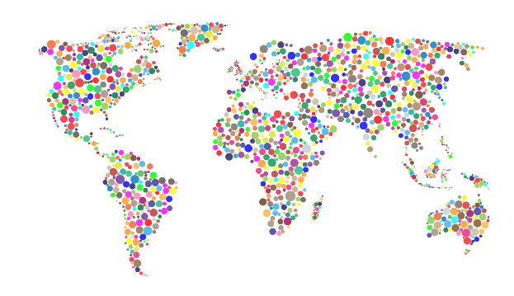
The International Council for Open and Distance Education
Quality Network
Ask the ICDE Experts Event 1
June 6, 2023

Slide 2
Introduction
ICDE Quality Network has a leading and coordinating role for quality enhancement of open, flexible and distance education.
ICDE Quality Network advices the Executive Committee in how ICDE should position its quality work on the global agenda.
Quality Network members collect and present knowledge on the latest developments of quality assurance within their institutions and respective regions.

Slide 3
Current Members
Name | Institution | Country/Region
Chair: Souma Alhaj Ali | Hamdan Bin Mohammed Smart University | United Arab Emirates
Yaping Gao | Quality Matters | North America
George Ubachs | EADTU | Europe
Mary Morocho Quezada | Universidad Técnica Particular de la Loja (UTPL) and CALED | Latin America
Obhajajie Juliet Inegbedion | National Open University of Nigeria (NOUN) | Africa
Ojat Darojat | Universitas Terbuka | Asia
Moustafa Hassan | Hamdan Bin Mohammed Smart University | Arab Region
Rajni Chand | University of South Pacific | Oceania

Slide 4
Mandate 2023-24
Enlighten, inspire, and encourage the adoption of high-quality standards and best practices in open, online, flexible, and distance education.
Support the development of ICDE Global Advocacy Campaigns for open, flexible and distance learning (OFDL).
Support the ICDE Conferences and Events.
Represent ICDE in external conferences and events relevant to quality.

Slide 5









Quality of open, online, flexible, and distance education
Organizational Aspects
Curriculum and Course Design
Course Delivery
Teaching and Learning Material
Assessment
Technology
Faculty and Professional Staff
Student Services
Quality Assurance, IS, and RM

Slide 6
Thank You

